Slide 1










Presented by: Kate Kirslet Sabio
MediSked: Hospital
Scheduling and Billing Management System

Slide 2







Introduction
MediSked is a desktop hospital scheduling and billing management system built with Python, CustomTkinter GUI, and SQLite database. It automates appointment booking, doctor availability tracking, patient records, and payment processing for small clinics, eliminating paper-based workflows. Four roles: Admin, Doctor, Cashier, and Receptionist, that operate under strict access controls, with only Admin creating accounts for all users.
01.

Slide 3




Statement of the Problem
Inefficient Manual Processes
Healthcare staff spend excessive time on administrative tasks such as manually scheduling appointments, searching through physical records, and processing payments. This reduces the time available for actual patient care and creates bottlenecks during peak hours when multiple patients require simultaneous attention.
Scheduling Conflicts and Double Bookings
Without a centralized system to track doctor availability in real-time, receptionists frequently encounter scheduling conflicts, resulting in double bookings, patient dissatisfaction, and wasted doctor time. The lack of visibility into each doctor's schedule across different staff members compounds this issue.
Disorganized Patient Information
Patient records scattered across paper files make it difficult to quickly retrieve medical histories, previous appointments, or billing information. This fragmentation leads to longer wait times, potential medical errors, and poor continuity of care.
Billing and Payment Tracking Challenges
Manual billing processes are prone to errors, lost invoices, and delayed payments. Cashiers struggle to maintain accurate records of outstanding balances, completed payments, and financial reconciliation, resulting in revenue leakage and accounting discrepancies.
Lack of Access Control and Accountability
Paper-based systems offer no mechanism to restrict access to sensitive information or track who performed specific actions. This creates security vulnerabilities and makes it impossible to audit staff activities or maintain proper data confidentiality in compliance with healthcare privacy standards.
02.

Slide 4
Objectives of the Study
To develop a role-based desktop application using Python, CustomTkinter, and SQLite that supports Admin, Doctor, Cashier, and Receptionist workflows for hospital scheduling and billing.
To centralize appointment data, doctor availability, and payment status in a single database using SQLite to reduce inconsistencies and lost records.
To minimize scheduling and billing errors by enforcing validation rules, preventing double-booking, and clearly tagging paid and unpaid appointments.
To enhance security and accountability through admin-controlled account creation and activity logging for all user actions.
03.

Slide 5
Scope and Limitations
In Scope
✓ Appointment scheduling
✓ Billing & payments
✓ Patient records
✓ Reporting
Out of Scope
✗ Web/mobile access
✗ Multi-user network
✗ External integrations
✗ E-prescriptions

Slide 6
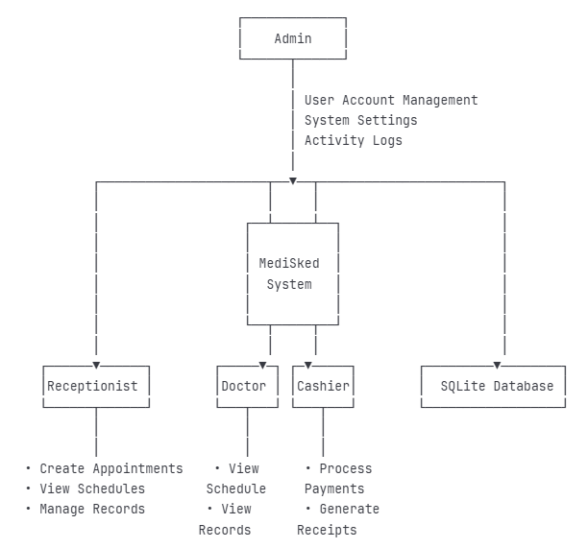
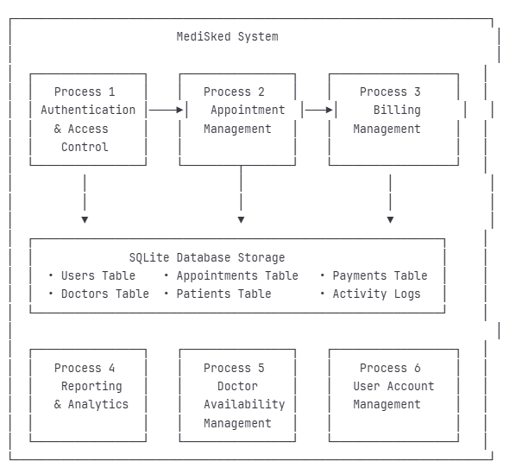
Data Flow Diagrams (DFD)
Figure 1. DFD Level 0
Figure 2. DFD Level 1

Slide 7
System Implementation
Hardware: Recommended Configuration
Processor: Intel Core i5+ (2.5 GHz+)
RAM: 8 GB or more
Storage: 1 GB (SSD preferred)
Display: 1920 x 1080 or higher
Input: Keyboard, mouse, barcode scanner (optional)
Software Requirements
Operating System:
Windows 10/11 (64-bit)
macOS 10.14+
Linux (Ubuntu 20.04 LTS+)
Runtime & Database:
Python 3.8+ (3.10/3.11 recommended)
SQLite 3 (included)

Slide 8




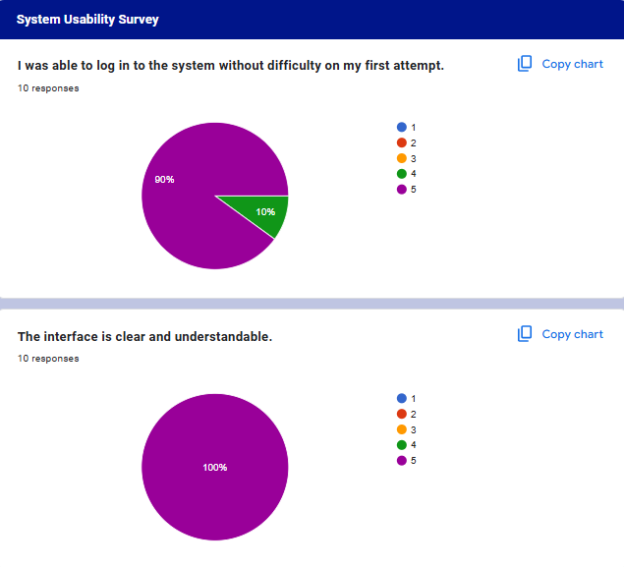


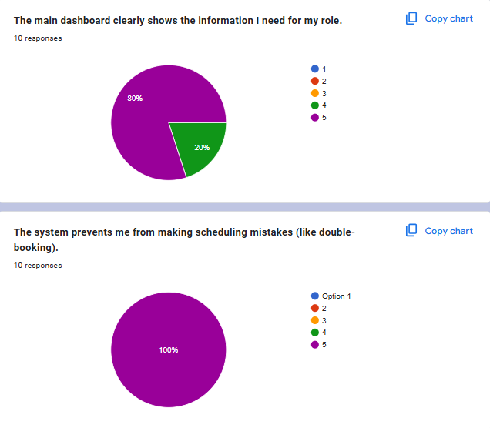
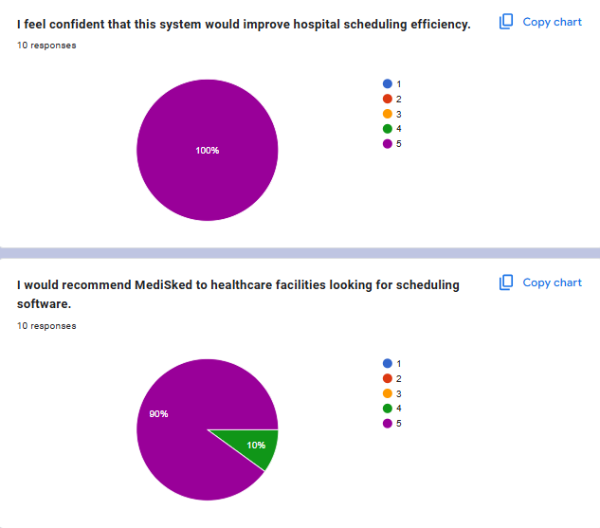
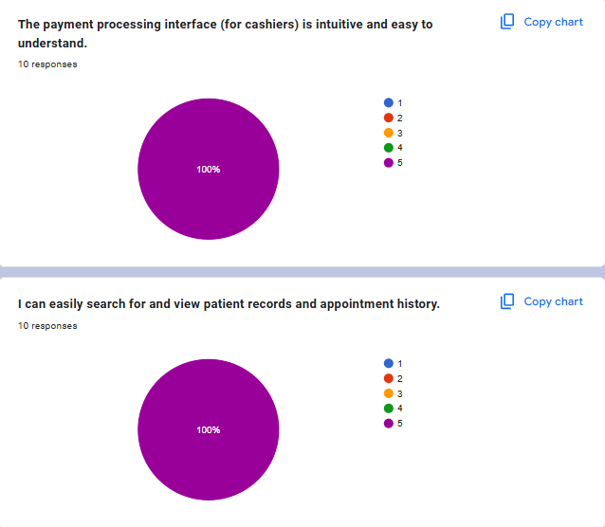
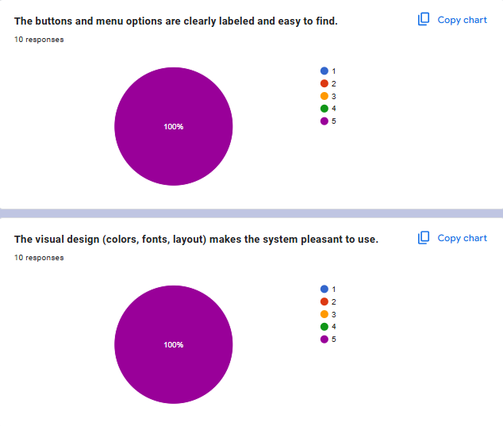
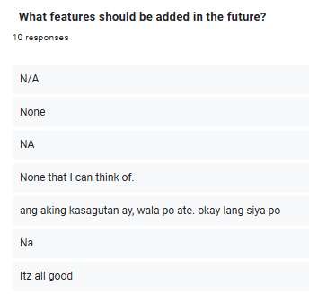
Survey Questions (User Feedback Form)

Slide 9


Summary and Conclusion
MediSked successfully automates healthcare administrative workflows for small-to-medium clinics, improving efficiency, reducing errors, and enhancing patient care delivery.

Slide 10

Recommendations
Web Portal - Patient online appointment booking
Mobile App - Doctor remote schedule access
SMS/Email Reminders - Automated notifications
Self-Check-in Kiosks - Patient convenience features

Slide 11










Thank You
Presented by: Kate Kirslet Sabio

